Slide 1
A current Linked (Open) Data System at Geoscience Australia
By Nicholas Car

Slide 2
What is Linked Data?
“Linked Data provides a publishing paradigm in which not only documents [web pages] but also data can be first class citizens of the Web”^{[1]}
^{[1]} Linked Data: Evolving the Web into a Global Data SpaceHeath, T. & Bizer, C., 2011. Linked Data: Evolving the Web into a Global Data SpaceJ. Hendler, ed., Morgan & Claypool. Available at: http://linkeddatabook.com.

Slide 3
What is Linked Data?
“Linked Data provides a publishing paradigm in which not only documents [web pages] but also data can be first class citizens of the Web”^{[1]}
The Semantic Web is an extension of the Web through standards by the World Wide Web Consortium (W3C). The standards promote common data formats and exchange protocols^{[2]}
^{[1]} Linked Data: Evolving the Web into a Global Data SpaceHeath, T. & Bizer, C., 2011. Linked Data: Evolving the Web into a Global Data SpaceJ. Hendler, ed., Morgan & Claypool. Available at: http://linkeddatabook.com.
^{[2]} https://en.wikipedia.org/wiki/Semantic_Web

Slide 4
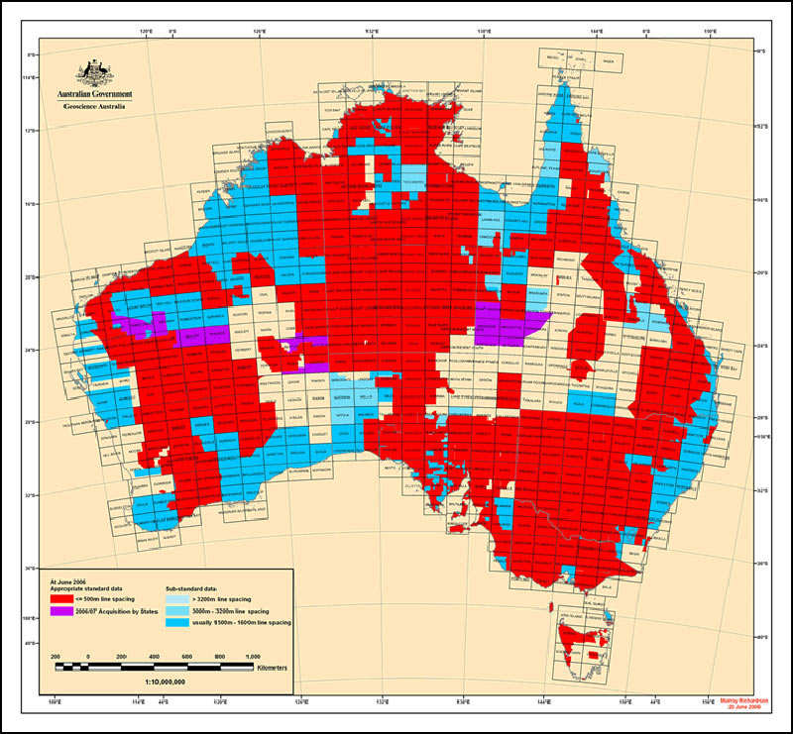
Surveys API
GA has a DB of Surveys – ship or airborne surveys undertaken to collect geophysical data such as the gravity or magnetic signatures of the earth or seafloor.
Airborne gamma-ray data

Slide 5
Surveys API
What we had
Geoscience Australia
Editing Application
Data
Surveys DB
Oracle

Slide 6
Surveys API
What we had
National Computational Infrastructure
Geoscience Australia
Editing Application
Data
Surveys DB
Oracle
Elsewhere

Slide 7
Surveys API
What we had
National Computational Infrastructure
metadata replication
Geoscience Australia
Editing Application
Data
Surveys DB
Oracle
Elsewhere

Slide 8
Surveys API
What we have done
XML
Geoscience Australia
Editing Application
Data
Surveys DB
Oracle

Slide 9
Surveys API
What we have done
Linked Data API
XML
Geoscience Australia
Editing Application
Data
Surveys DB
Oracle

Slide 10
Surveys API
PIDs
What we have done
Linked Data API
XML
Geoscience Australia
Editing Application
Data
Surveys DB
Oracle

Slide 11
Surveys API
PIDs
What we have done
National Computational Infrastructure
Linked Data API
XML
Geoscience Australia
Editing Application
Data
Surveys DB
Oracle

Slide 12
Surveys API
Semantic Web
PIDs
What we have done
Linked Data API
XML
Geoscience Australia
Editing Application
Data
Surveys DB
Oracle

Slide 13
Surveys API
Semantic Web
PIDs
What we have done
Linked Data API
XML
Geoscience Australia
Editing Application
Data
Surveys DB
Oracle
Elsewhere

Slide 14
Surveys API
Underlying tools
PIDs
Semantic Web
Linked Data API

Slide 15
Surveys API
Underlying tools
Things on the web can have Persistent Identifiers (PIDs) made of long-lasting URIs
PIDs
Semantic Web
Linked Data API

Slide 16
Surveys API
Underlying tools
Things on the web can have Persistent Identifiers (PIDs) made of long-lasting URIs
A GA Survey: http://pid.geoscience.gov.au/survey/801
PIDs
Semantic Web
“the web”
The ID
Basic type of thing
A domain not tied to an Org name
An isolated subdomain, for management
Linked Data API

Slide 17
Surveys API
Underlying tools
Things on the web can have Persistent Identifiers (PIDs) made of long-lasting URIs
A GA Survey: http://pid.geoscience.gov.au/survey/801
PIDs
Semantic Web
Web Page
Data
Linked Data API

Slide 18
Surveys API
Underlying tools
Things on the web can have Persistent Identifiers (PIDs) made of long-lasting URIs
A GA Survey: http://pid.geoscience.gov.au/survey/801
PIDs
Semantic Web
Data
Linked Data API
netCDF file, with a header containing the URI

Slide 19
Surveys API
Underlying tools
PIDs
What GA calls a Survey can be classed as a type of PROV Activity
Activities can have certain properties:
Activity → generated → Dataset
Semantic Web
Surveys DB
Oracle
Data
Linked Data API

Slide 20
Surveys API
Underlying tools
PIDs
What GA calls a Survey can be classed as a type of PROV Activity
Activities can have certain properties:
Activity → generated → Dataset
Semantic Web
Surveys DB
Oracle
Data
Linked Data API
netCDF file, with a header containing URI, and an indication of the relationship

Slide 21
Surveys API
Underlying tools
PIDs
Semantic Web
Like any normal API, list, get, etc.
Delivers multiple “views” for multiple models
Delivers multiple formats per view
Linked Data API

Slide 22
LIVE WEB DEMO
http://pid.geoscience.gov.au/survey/
http://pid.geoscience.gov.au/survey/801

Slide 23
Go forth and Link!
Nicholas Car
Data Architect
Geoscience Australia
nicholas.car@ga.gov.au
Australian Government Linked Data Working Group
http://linked.data.gov.au

